Slide 1

SMS Fraud Detection using Machine Learning
By Robert Hughes

Slide 2
Understanding the issue
The issue that this project aims to tackle is the persistent and harmful acts of SMS fraud, which take place everyday.
To target this problem, my applications focus is to provide users a platform where they can scan their messages and receive feedback results.
The federal trade communication estimated that every year scammers steal a total of $8.6 billion from just US citizens alone (Ali, et al., 2019).

Slide 3
Solution & Aims
To solve this problem, this app aimed to provide users a high-quality platform to submit and scan their messages.
AIMS
Create an efficient and high performing ML Model.
Train and test the model using a large dataset of spam/ham messages.
Display quick, instant, and accurate predictions to the user.
Provide an easy to understand and use interface.
Conduct a thorough evaluation and analysis of the final application.

Slide 4
System component design
Machine Learning
Process
This is the system component design, which displays how the application will use Machine Learning to process the user requests.
Training
Dataset
FastForest ML Algorithm
ML Model: SpamDetector
UI Display
Input:
SMS Message
Prediction Process
Output:
Result & Explanation

Slide 5
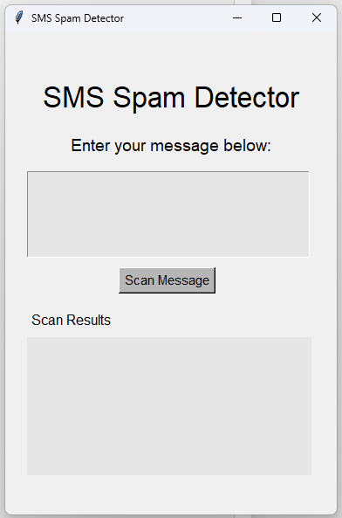
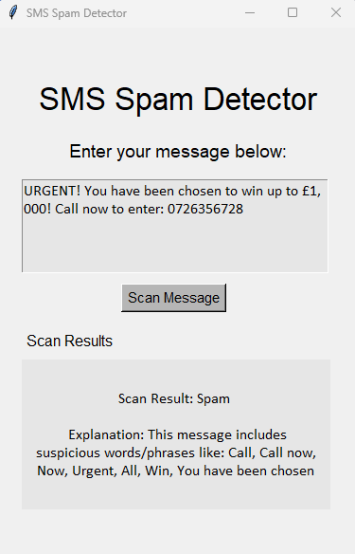
prototype
The images to the right display the initial SMS detection prototype that was created in python.
This prototype worked successfully; however, I aimed to create a multi-platform tool and provide a better user interface and user experience.

Slide 6
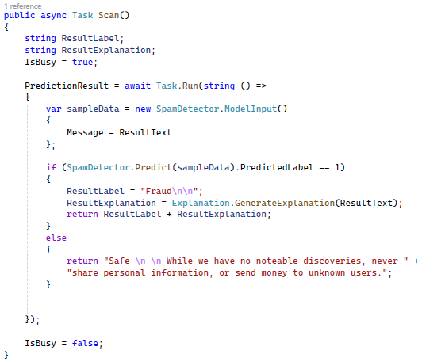
Fast forest ova, algorithm
Ensemble Learning – The algorithm trains multiple decisions trees in the training process.
One vs All – This strategy means that for each label, Spam / Ham, they have their own binary classifier.
Probabilistic Results - This algorithm uses probability scores to determine its results. This chooses the class with the highest probability score across all classifiers.

Slide 7
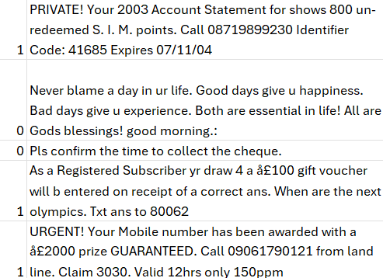
Training the model
To train the model I used a SMS spam/ham dataset provided by Kaggle, which contained over 5,000 labelled messages.
Half of the dataset would be used for training the model and the other half would help evaluate and test its performance

Slide 8
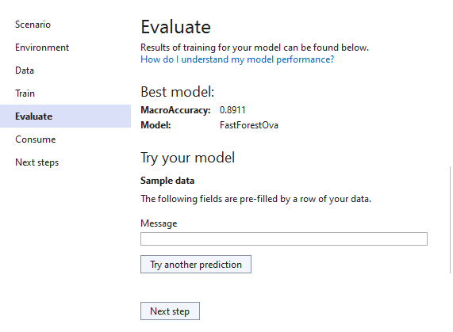
Evaluation
When evaluating the model, it achieved an accuracy score of 89%.
The rigorous testing found that there were some false negatives / positives that with further development would need to be resolved.

Slide 9
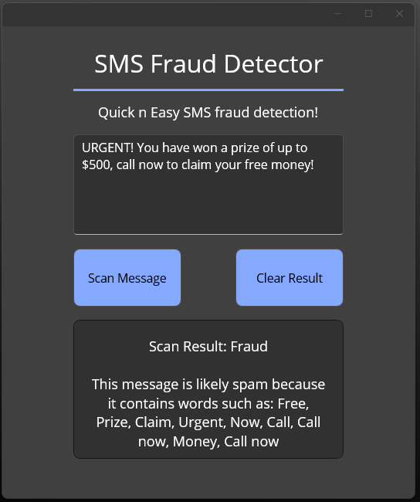
Final application
My final product provided a simplistic user interface, with easy to use and understand control buttons.
The finished app was able to receive, analyse and provide the user with accurate results.
With this the app was able to provide an explanation on how the language used led to this result.

Slide 10
Questions?

